Slide 1
Marvel Students Database
michelle kutsanov :)

Slide 2
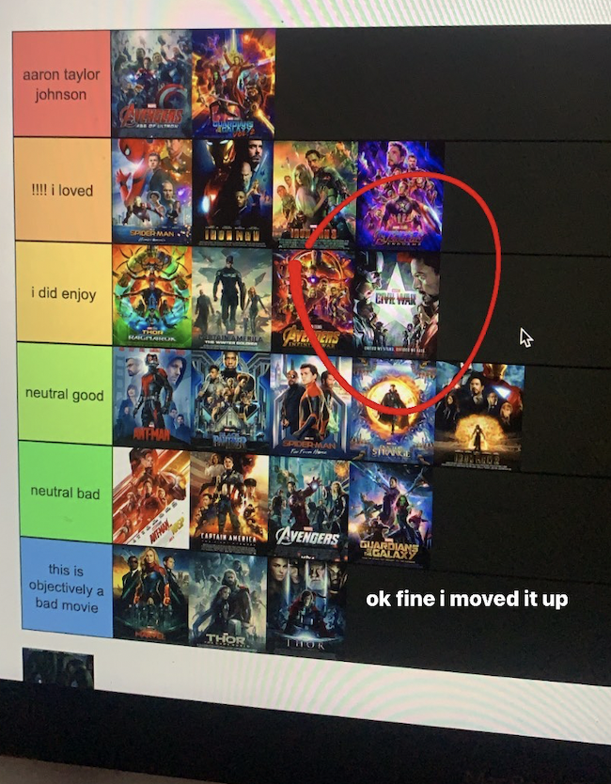
Issue I am working to resolve:
Fun take on the Students database we were working on earlier in the semester
Helps keep track of/monitor students in this fictional school I am creating
Such an abundance of data if we are creating data for a whole university
Simple functions that modify the database without losing any key information

Slide 3
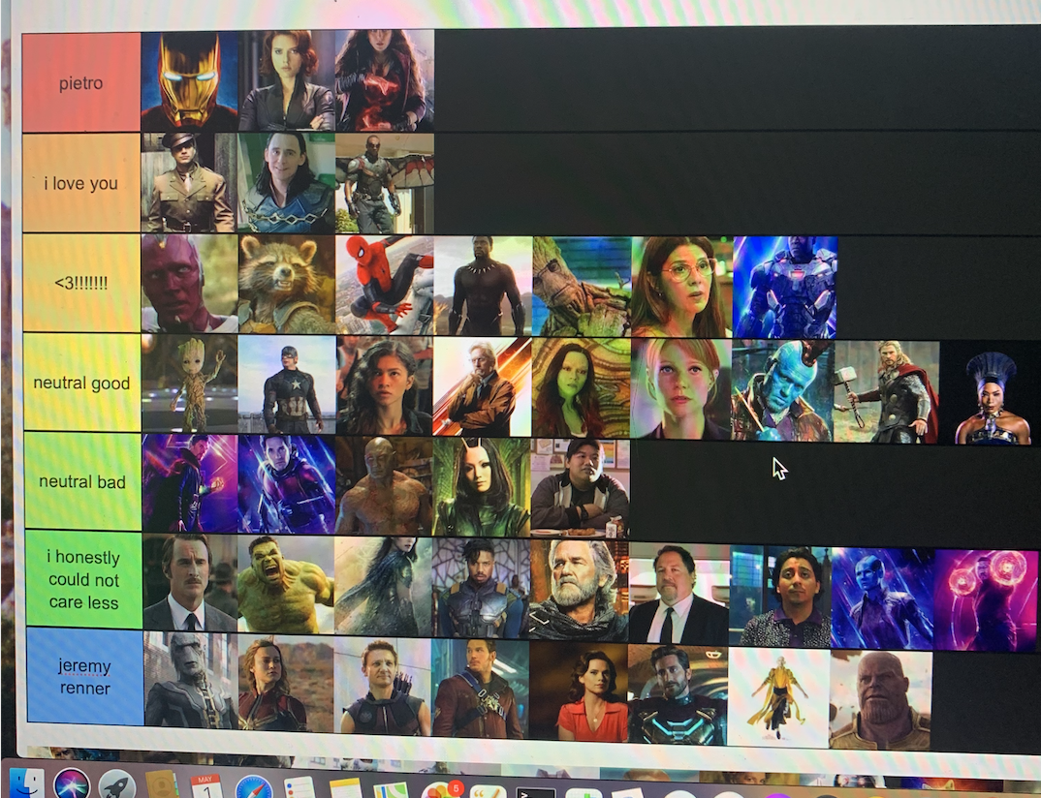
Solution to the issue(s):
In terms of making sure the data is palatable for the user, I made use of multiple Views so they can monitor what is going on as they modify the database information

Slide 4
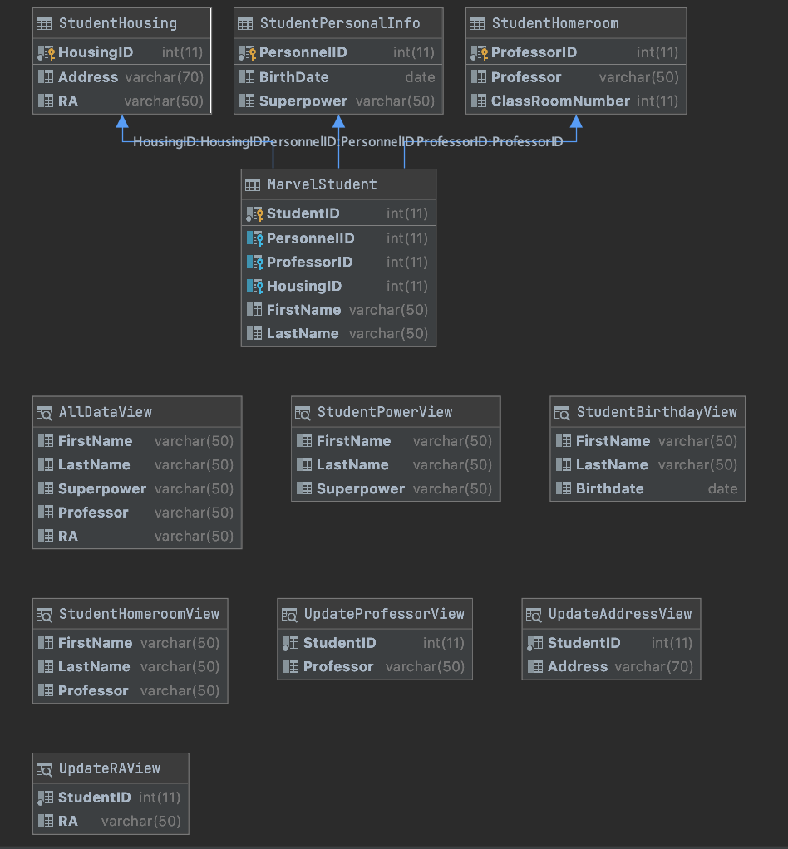
Schema Diagram!

